Slide 1
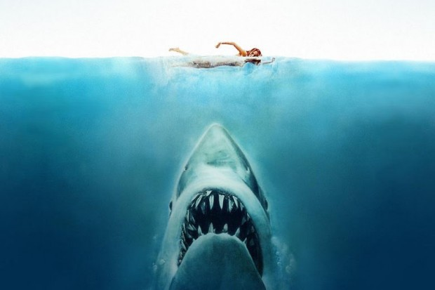
Global Shark Attacks
Johnny | Guillermo | Daniel

Slide 2
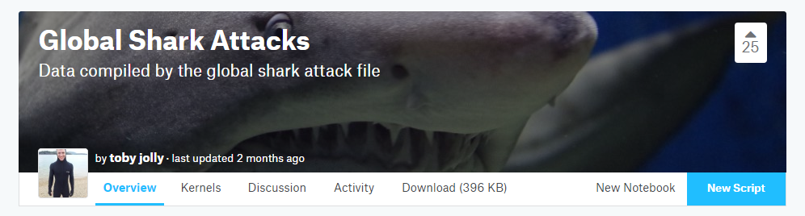
Data Source
https://www.kaggle.com/teajay/global-shark-attacks

Slide 3
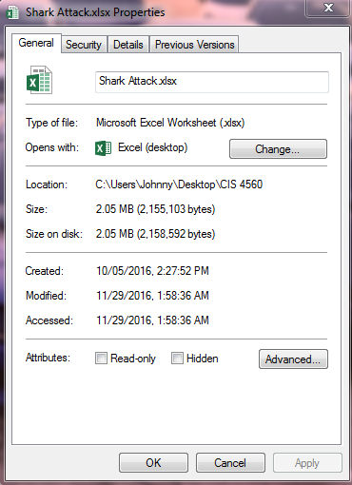
Data Size
File Size : 2.05 MB
Entries : 5992 excluding line 1

Slide 4
HDFS & HIVE

Slide 5
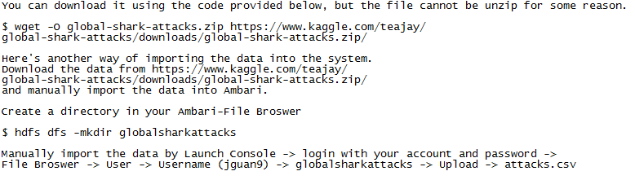
HDFS

Slide 6
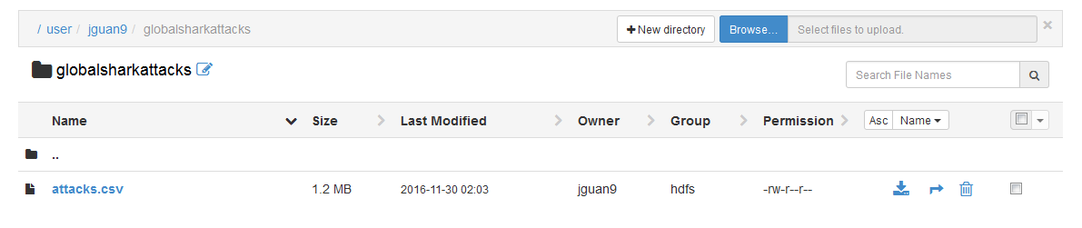
Ambari - File Browser

Slide 7
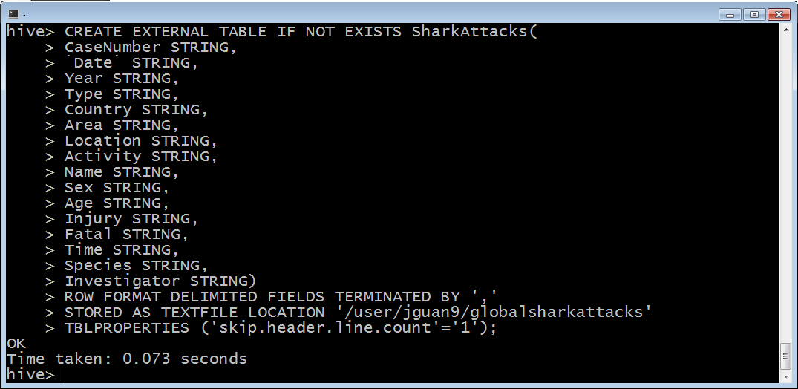
HIVE

Slide 8
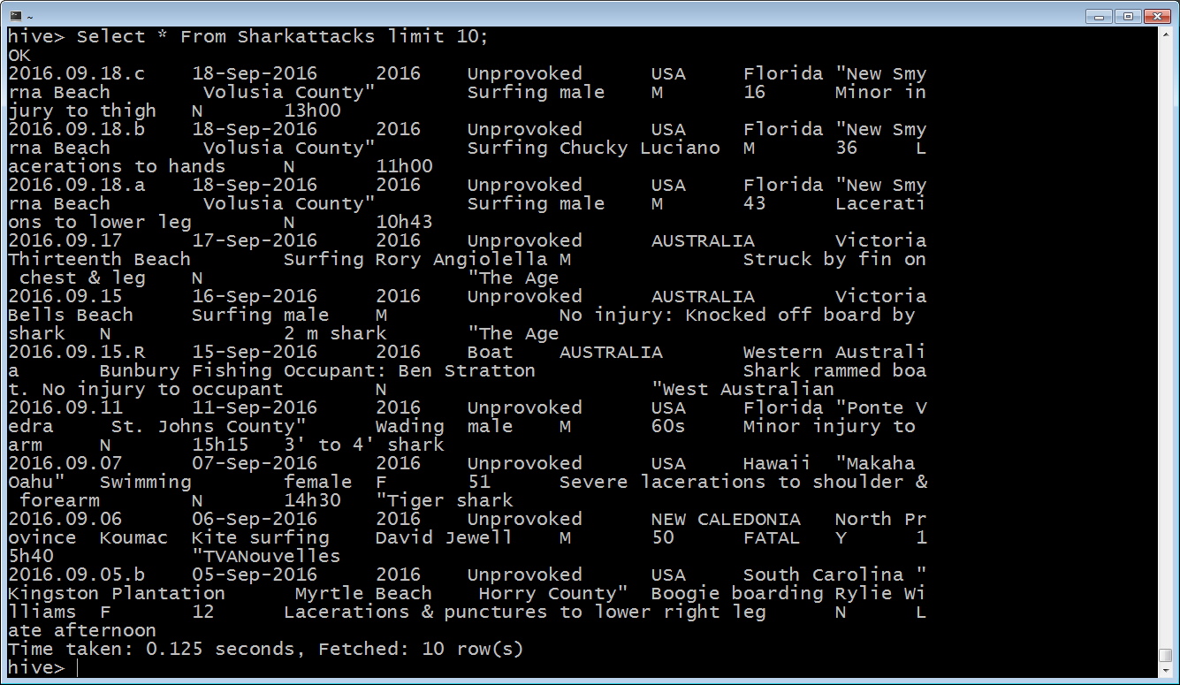
HIVE

Slide 9
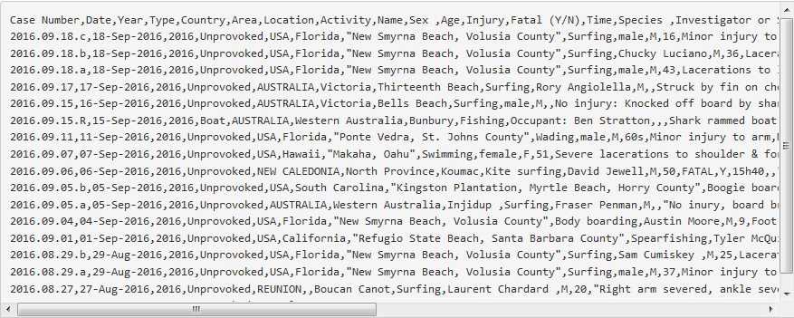
Ambari - File Browser

Slide 10
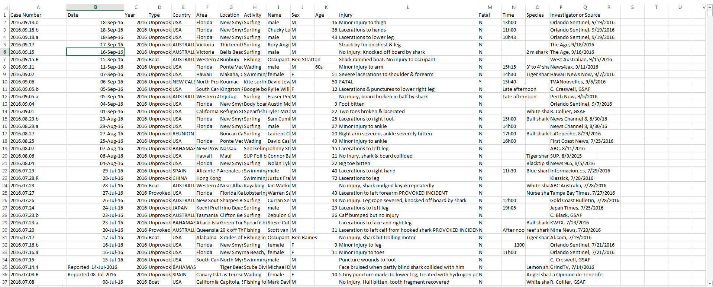
Excel

Slide 11
Visualization

Slide 12
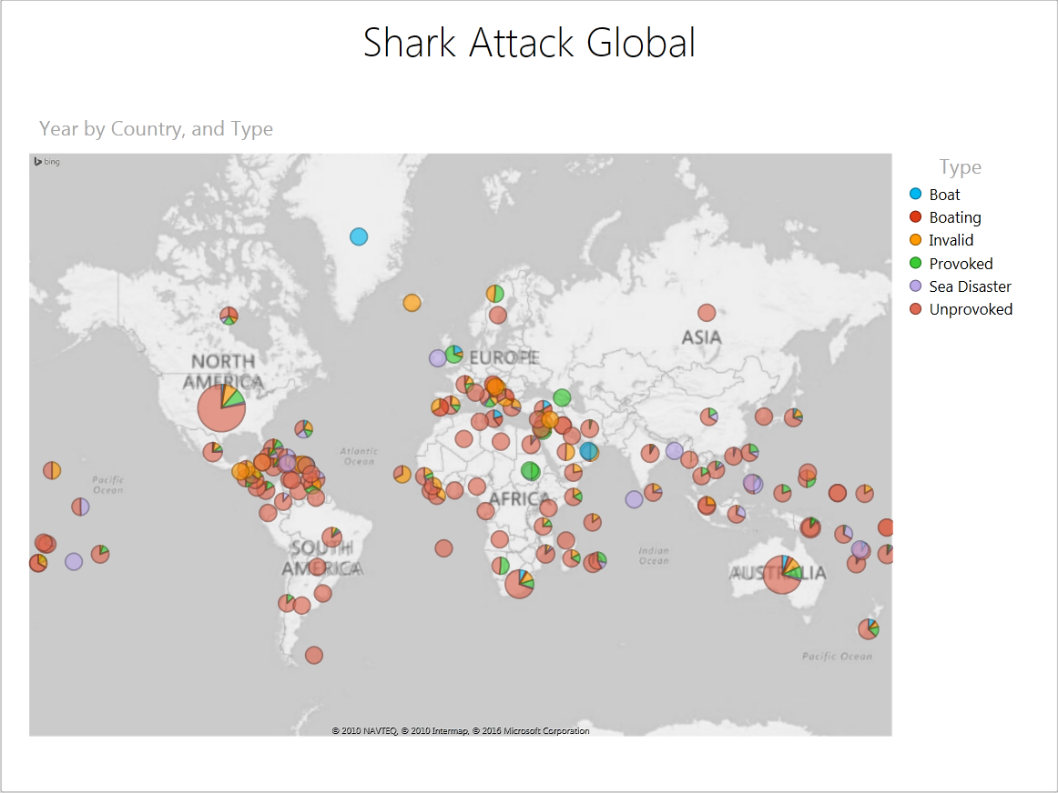
Top Countries
U.S. - 2116
Australia - 1279
South Africa - 565
Papua New Guinea - 133
New Zealand - 125

Slide 13
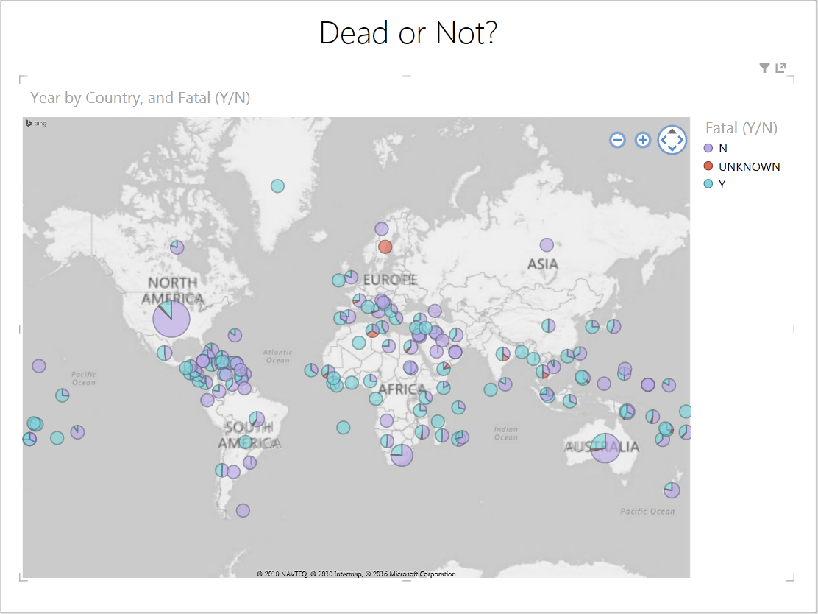
Dead or Not?
Yes : 1552
No : 4317
Unknown : 94

Slide 14
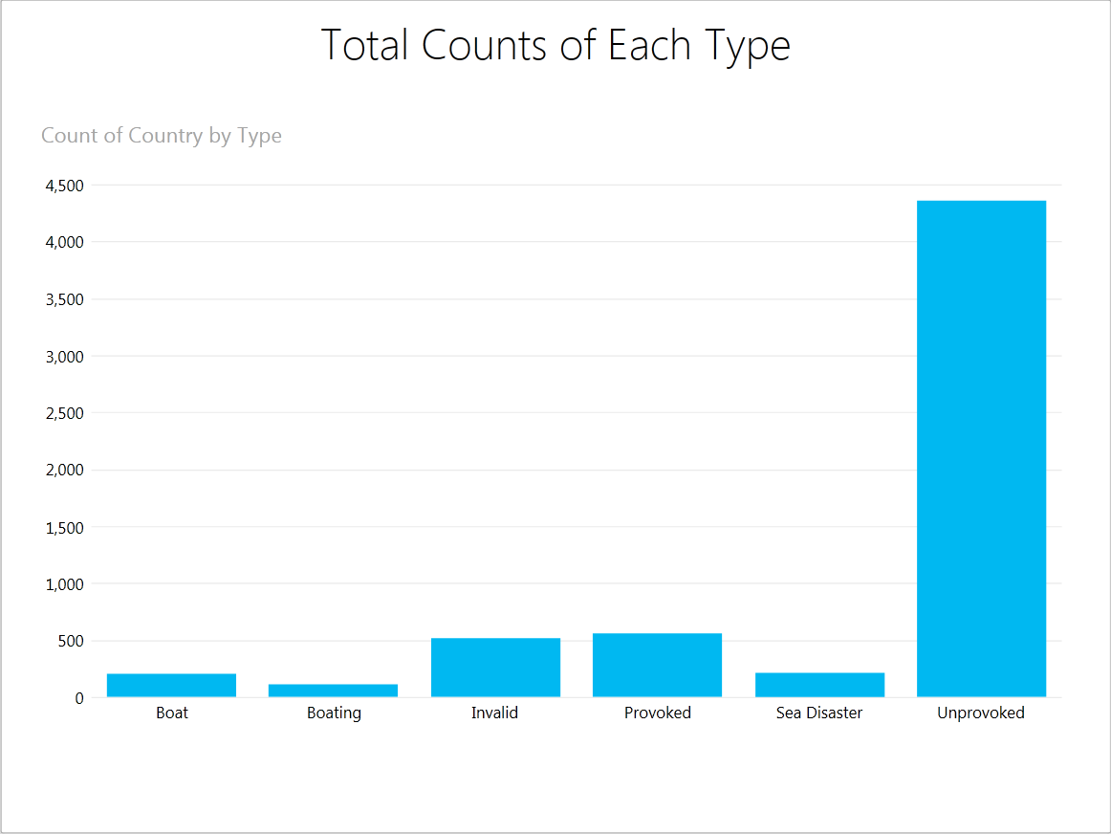
Types
Boat : 200
Boating : 110
Invalid : 519
Provoked : 557
Sea Disaster : 220
Unprovoked : 4386

Slide 15
Interesting Facts

Slide 17
Earliest Recorded Shark Attack
725 B.C.
Italy
Sea Disaster
Vase depicts shipwrecked sailors, one of whom is being attacked by a shark
Fatal : No

Slide 18
FATAL Injury Description
FATAL, arm bitten by shark hauled on deck (PROVOKED INCIDENT)
Disappeared. No evidence that he was taken by a shark
Probable drowning with post-mortem bites
Killed by a shark or crocodile.
Death was due to drowning. Two days later his remains were recovered from a 12' tiger shark
Body not recovered

Slide 19
References
https://www.kaggle.com/teajay/global-shark-attacks
https://www.kaggle.com/forums/f/1605/global-shark-attacks/t/24869/hilarious-outliers

Slide 20

QUESTIONS?

